Slide 1


Building a Nordic ecosystem for smart,
sustainable and liveable communities
Smart Energy network
21. mai 2019
Notes:
Betydningen av å ha nasjonal smart city innovasjonsklynge med nordisk profil og internasjonalt nedslagsfelt.
Hvordan bygger vi et smartby-økosystem som skaper næringsutvikling?

Slide 2
GRÜNDERE
FORSKNING OG UTDANNING
RISIKO-
KAPITAL
OFFENTLIGE
MYNDIGHETER
§
ETABLERTE
BEDRIFTER

Slide 3

WHY THE NORDICS?
A distinctive welfare state model
High quality urban solutions
Smart governance
Public-private partnerships
Environmental and social consciousness
Early adopters of new technology
Digital infrastructure
Well-functioning democracies
Ideal test-bed for new smart city solutions
Notes:
Why will the next generation solutions arise in the Nordics?

Slide 4
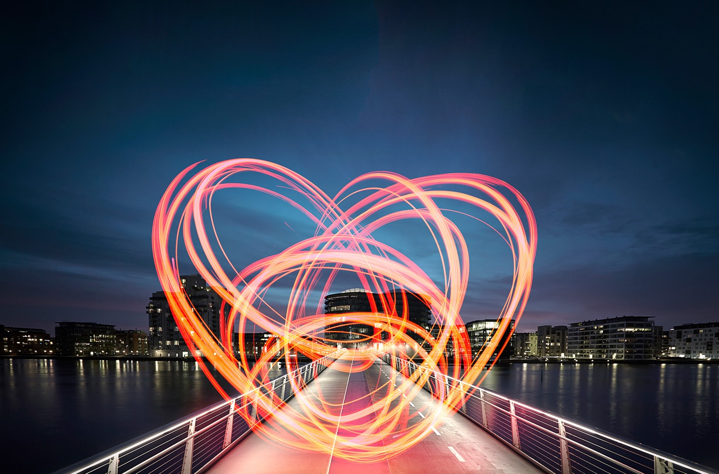


Slide 5
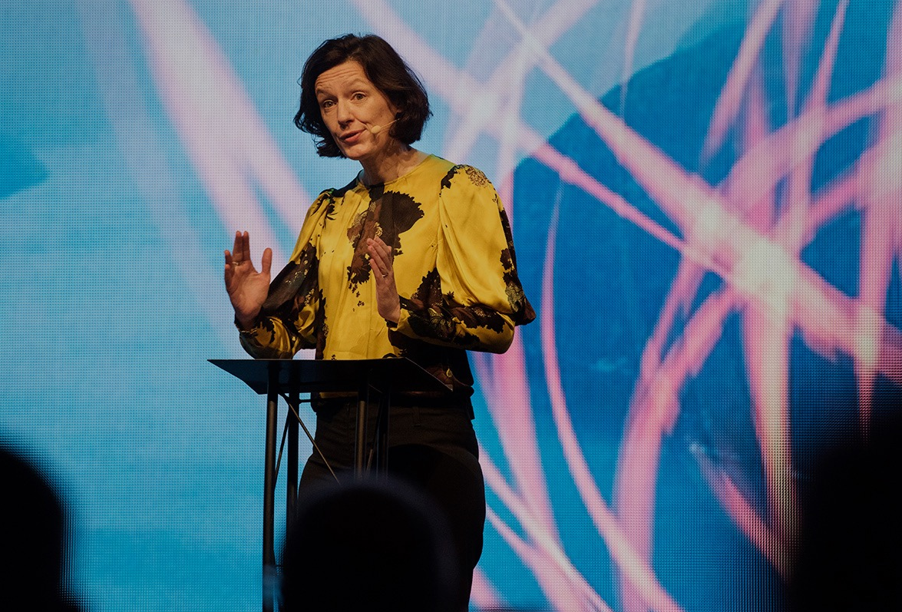
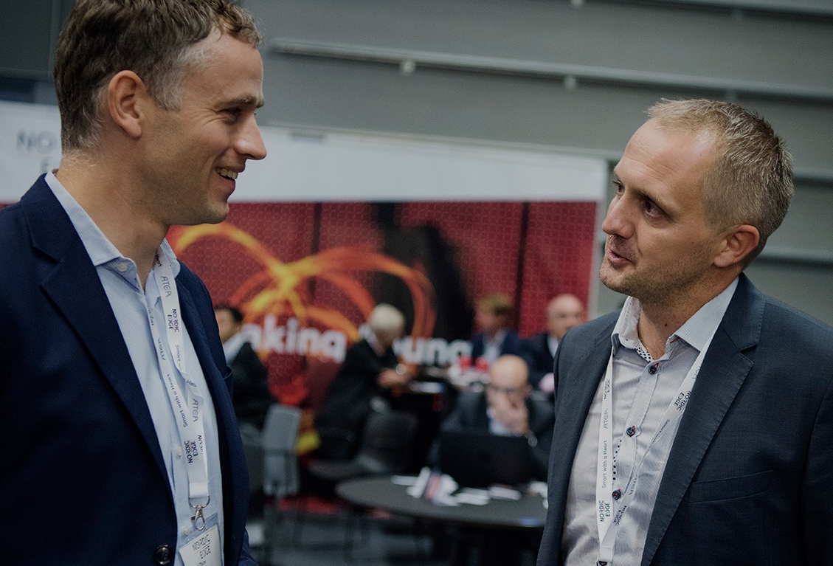
Nordic Edge – the Smart City matchmaker and accelerator
The Event Organizer
The Innovation Cluster

Slide 6


Slide 7
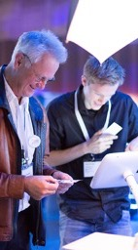
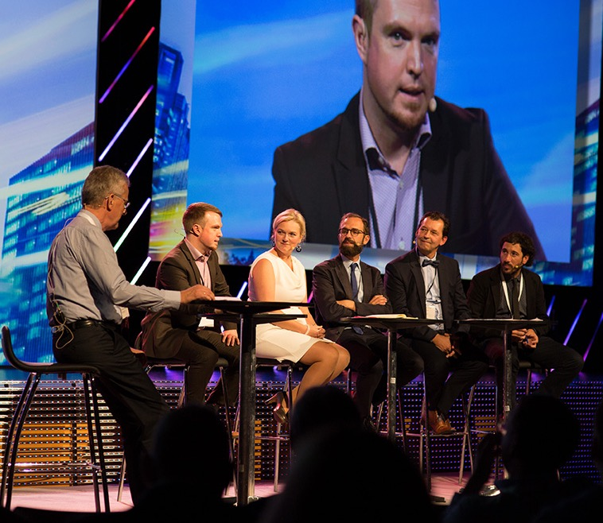




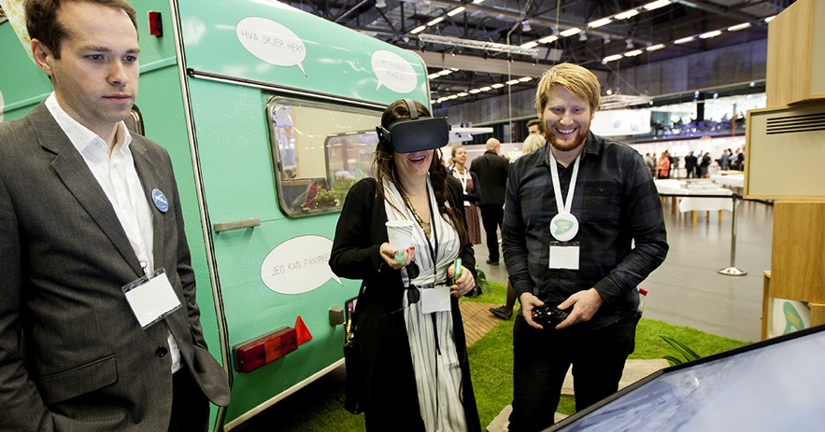
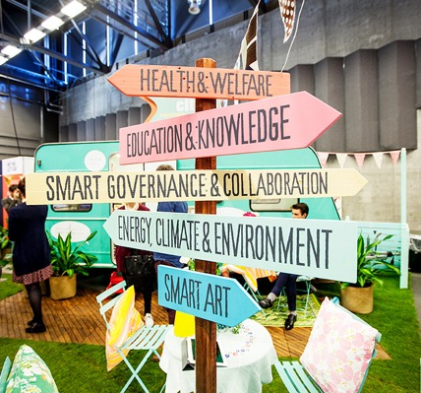
Some highlights from 2018
NORDIC EDGE EXPO
4500+
VISITORS
150
SPEAKERS
200
EXHIBITORS
47
COUNTRIES
200+
EXHIBITORS
Delegates: 50/50% public vs. private sector
58 municipalities
120 cities
> 25 Nordic and international co-organizers
Smart City China (Beijing)
Smart City USA (Washington)

Slide 8




















Nordic Edge Expos medarrangører 2018

Slide 9
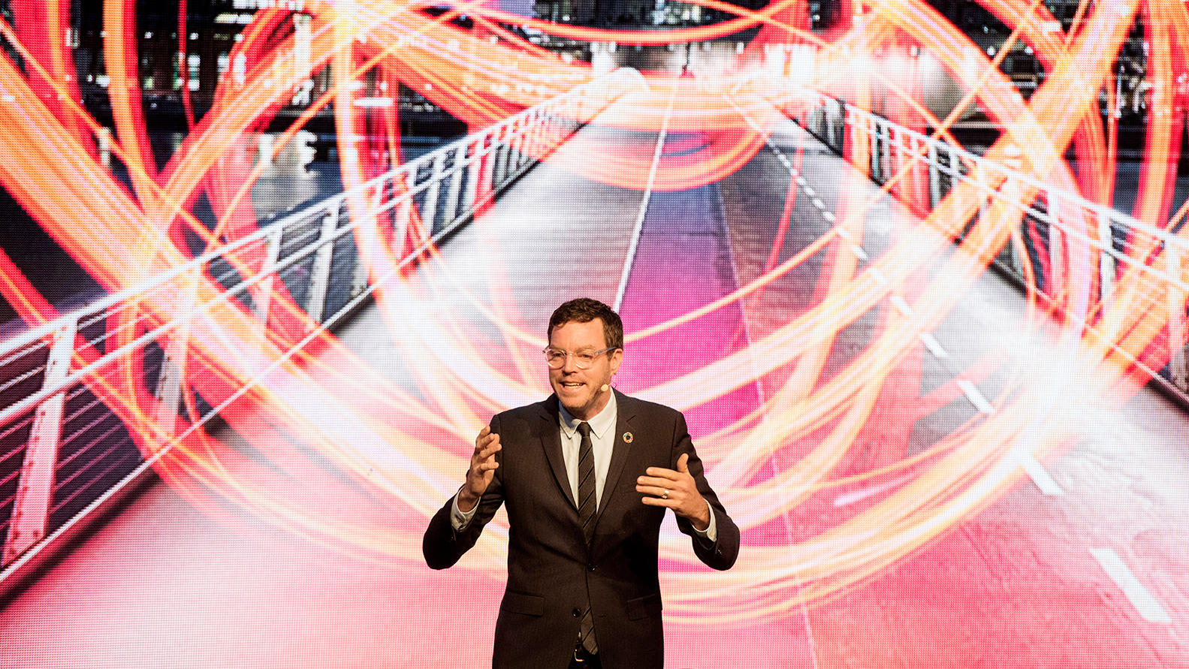
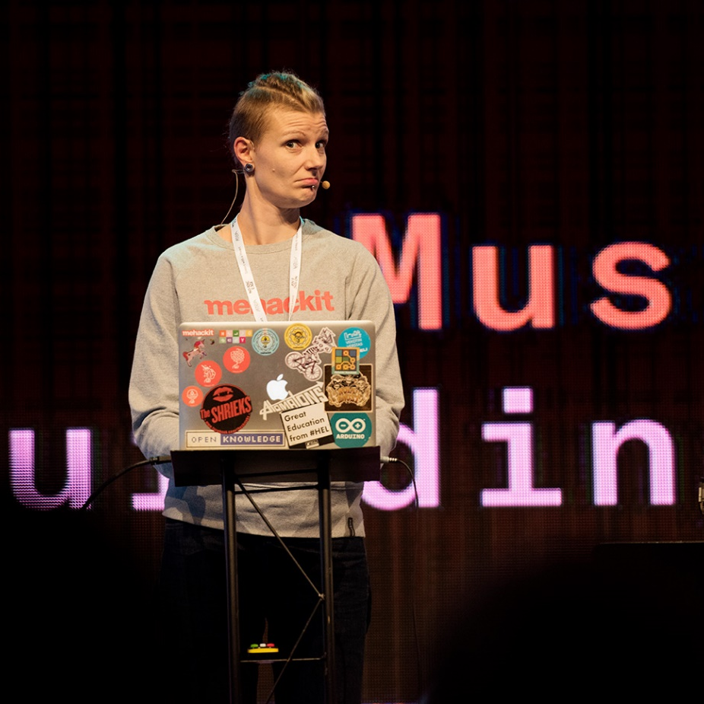
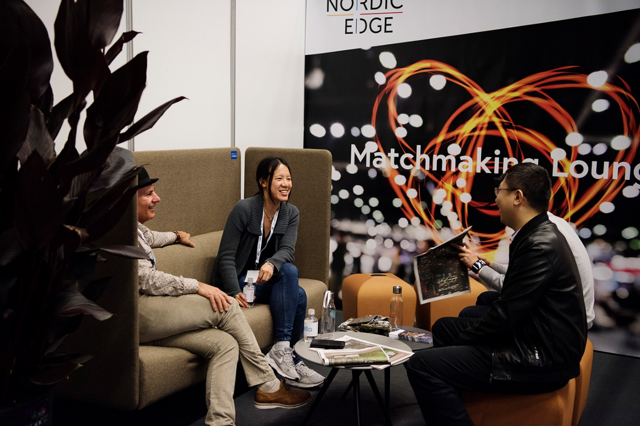
2019: Main topics
Smart City Ecosystems
Mobility and Transport
Active Citizenship and Democracy
Urban Energy
Smart Places and Spaces
Emerging technologies and platforms
Edtech and learning communities
Healthtech
Governance and Resilience

Slide 10


Slide 11

Nordic Edge China

Slide 12
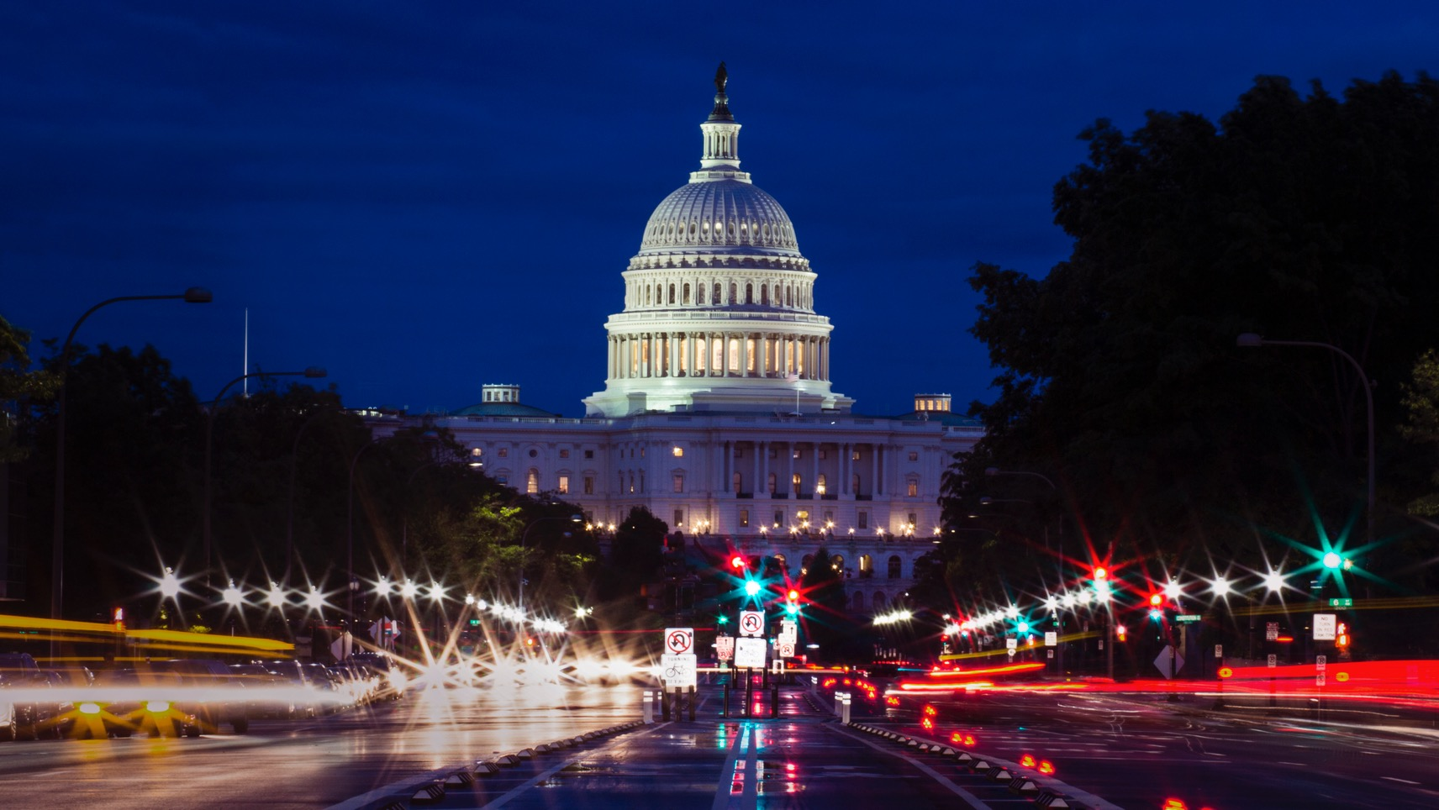
Nordic Edge Washington

Slide 14


Smart City Innovation Cluster
Smart City Innovation Cluster er en del av Norwegian Innovation Cluster. For økt innovasjon og samarbeid mellom bedrifter, forsknings- og utdanningsmiljøer, og offentlige aktører.

Slide 15
De fremste barrierene i dagens smartbyutvikling
§
FORSKNING OG UTDANNING
OFFENTLIGE
MYNDIGHETER
GRÜNDERE
IDENTIFISERE UTFORDRINGER
OG ÅRSAKER
RISIKO-
KAPITAL

Slide 16
De fremste barrierene i dagens smartbyutvikling
§
FORSKNING OG UTDANNING
OFFENTLIGE
MYNDIGHETER
§
GRÜNDERE
IVERKSETTE KONKRETE
VIRKEMIDLER
RISIKO-
KAPITAL

Slide 17

Smart City Themes: Our 4 main focus areas
Projects, innovative technology, policy initiatives, programs, research, analysis and complete solutions that demonstrate how core Smart City challenges can be solved:
ACTIVE CITIZENSHIP AND KNOWHOW
Diverse and inclusive learning communities
ON THE MOVE
Blue and green mobility and transport solutions
URBAN ENERGY
The renewable transformation challenge; Smart energy concepts for a cleaner and leaner future
SPACES AND PLACES
Reinventing our human-made surroundings
KPI’s: applicability, impact, sustainability and scalability

Slide 18
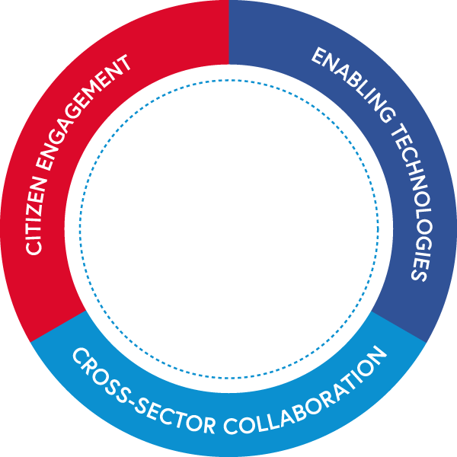
Building a robust
Smart City Ecosystem
THE EXPOS & EVENTS
Nordic Edge Expo - the largest smart city conference and exhibition in the Nordics
Nordic Edge China (Beijing)
Nordic Edge USA (Washington)
Matchmaking events, breakfast meetings, networking sessions, product presentations.
THE STARTUP AND SCALEUP ACCELERATOR
Empowering Smart City startups and scaleups through funding, incubation, network and coaching
THE PROJECT DEVELOPER
Active Citizenship and Knowhow - Diverse and inclusive learning communities
On The Move - Blue and green mobility and transport solutions
Urban Energy - The renewable transformation challenge
Spaces and Places - Reinventing our human-made surroundings
THE SMART CITY INSTITUTE
Stimulating research, teaching, innovation and entrepreneurship in the field of the smart city
THE LIVING LAB
The Smart City Innovation Lab
The Smart City Showroom
Ullandhaug Innovation District
Stavanger and Ålgård City Centre

Slide 19


