Slide 1

Accelerating sustainability progress and business growth.
Alec Saunders

Slide 2

Decades of action
Our history 2009-2019
Our commitments 2020-2050
AI for Earth launch
LEED Gold certification for new datacenters
Carbon fee
raised to $15
Water replenishment goal set
100% carbon neutral
Internal carbon fee instituted
2030
2025
Become
carbon negative
Operate with 100% renewable energy
2009
2012
2016
2017
2018
2019
2030
2050
Become
zero waste
Remove all historic emissions
2025
First carbon emission reduction goal
Zero-waste campus certification
Supplier carbon engagement
in China launched
Net zero potable water
Silicon Valley campus groundbreaking
Protect more land than Microsoft uses
2030
Become
water positive
Notes:
Microsoft is not new to the topic of sustainability.
For more than a decade, we’ve steadily built on our commitment to innovation and investment in technologies to address environmental sustainability.
<CLICK>
We’ve landed important work ever since we set our first carbon emission reduction goal back in 2009, and we’ve focused our attention where we believe technology can have the greatest impact—in the areas of carbon, water, waste, and ecosystems.
<CLICK>
In 2020, we set new commitments to go beyond neutral to a real net zero target, and committed to become a carbon negative, water positive, zero waste company by 2030 that protects more land than it uses.
From 2030 to 2050, we’ll continue not just zeroing out our annual emissions, but go back in time and remove all the emissions we’re associated with since we were founded in 1975.
As we set these ambitious goals and established our roadmaps, we turned again and again to our deep experience and expertise in sustainability and software-driven innovation for data-driven approaches. And we recognized that to succeed, we needed to embed sustainability deeper into our culture.
Now, we’re prepared to work closely with our customers and partners to advance our collective progress, because we’ve discovered that for organizations of all kinds, in every industry, the overarching sustainability journey is similar. It’s been our own experience, and we see it with others, too.
<CLICK>
NOTES FOR THE PRESENTER
For more detail on Microsoft commitments and progress, see the Environmental Sustainability Report (https://aka.ms/msftsustainabilityreport).

Slide 3




The world is facing an extraordinary challenge—to stabilize our climate by building quickly towards net zero.
Here’s what we’ve heard from industries
Increasing regulation
Growing demand for change
Emerging market opportunities
Lack of a system of record
Companies are facing increasing pressure to make sustainability commitments and report their data and achievements.
Addressing the reputational, business, and global risks associated with environmental impact is a growing priority.
Economic data suggests that sustainability measures present incredible economic and market opportunities.
Organizations lack the
tools and technologies
to transform their
businesses sustainably in
an accurate, efficient, and
data-driven way.
Notes:
Slide title: The world is facing an extraordinary challenge-to stabilize our climate by building quickly towards net zero.
Organizations of all types, sizes, and sectors will need to fundamentally transform common practices to meet the new sustainability imperative—to operate with less environmental impact and grow their business to meet the demands of a changing world.
There are a few common trends related to sustainability that we’re hearing about from across industries:
Increasing regulation:
Companies of all sizes, industries, and geographies are facing increasing pressure to make sustainability commitments in line with the UN Paris Agreement and are limiting emissions within their borders—in some cases mandating environmental reporting.¹
The UN’s Principles for Responsible Investment expects there to be a global government response to climate change by 2025 that will be sudden, strained, and disorganized because of the delay.²
Additionally, new and proposed regulatory requirements, particularly in the EU, UK, and US, drive a need to capture data on current emissions and reduce future environmental impact.
Growing demand for change:
Addressing the reputational, business, and global risks associated with environmental impact is a growing priority for consumers, investors, and businesses alike.
~60% of consumers would pick a lower-impact brand given the choice.³
71% of investors agree that there will be an increase in awareness and actions to tackle risks related to climate change as a result of the COVID-19 pandemic.⁴
And 94% of top CEOs cite sustainability as important or very important to the future success of their businesses.⁵
Emerging market opportunities:
Economic data indicates there is a multi-billion-dollar opportunity to help businesses digitally transform for sustainability.
Bold climate action could deliver at least 26 trillion dollars in economic benefits through 2030. It could also produce over 65 million new low-carbon jobs.⁶
Globally, governments and utilities alone are expected to spend up to 60 billion dollars on energy efficiency technologies and investments by 2028.⁷
The International Energy Agency’s roadmap to net zero suggests that 640 billion dollars be invested each year until 2050 in energy efficiencies associated with deep retrofits of buildings and appliance replacement.⁸
There is a strong sustainability and ESG component to the global supply chain management market, which is projected to exceed $31 billion by 2027.⁹
The value of the global market for carbon emissions offsets could be worth 200 billion dollars by 2050.¹⁰
And current CAGR for the global green tech and sustainability market is estimated at 26.6% through 2025.¹¹
Lack of a system of record:
Organizations need a reliable solution to drive their sustainability transformation, one that provides continuous transparency into their carbon footprint by monitoring the effect of sustainability actions and delivering the intelligence to guide further reductions through new solutions and technologies. Most organizations lack the tools and technologies to transform their businesses sustainably in an accurate, efficient, and data-driven way.
Up to 90% of an average company’s resource footprint occurs either upstream or downstream of its own operations, and sourcing carbon credits to offset unavoidable emissions is a difficult process.¹²
Companies are challenged by data that is poor quality and siloed between different systems, and difficult to share along value chains.
95% of customers also express a strong desire to have a solution for data management and automated reporting.¹³
<CLICK>
Sources:
¹“Key aspects of the Paris Agreement,” UNFCC, December 2015
Link: https://unfccc.int/process-and-meetings/the-paris-agreement/the-paris-agreement/key-aspects-of-the-paris-agreement
²”What are the Principles for Responsible Investment?” PRI, 2021
Link: https://www.unpri.org/about-us/what-are-the-principles-for-responsible-investment
³”Global Consumer Insights Pulse Survey (The global consumer: Changed for good),” PwC, June 2021
Link: https://www.pwc.com/gx/en/consumer-markets/consumer-insights-survey/2021/gcis-june-2021.pdf
⁴”Delivering on the promise of sustainability,” Accenture, 2021
Link: https://www.accenture.com/_acnmedia/PDF-150/Accenture-Delivering-on-the-Promise-of-Sustainability.pdf
⁵”The Decade to Deliver: A Call to Business Action,” Accenture, September 2019
Link: https://www.accenture.com/_acnmedia/PDF-109/Accenture-UNGC-CEO-Study.pdf#zoom=40
⁶“Climate Smart Growth Could Deliver 26 Trillion USD to 2030, UNFCC, September 2018
Link: https://unfccc.int/news/climate-smart-growth-could-deliver-26-trillion-usd-to-2030-finds-global-commission
⁷”Navigant Research Report Shows Global Electric Energy Efficiency Spending Is Expected to Near $60 Billion by 2028,” Business Wire, February 2020
Link: https://www.businesswire.com/news/home/20200212005030/en/Navigant-Research-Report-Shows-Global-Electric-Energy-Efficiency-Spending-Is-Expected-to-Near-60-Billion-by-2028
⁸”Net Zero by 2050: A Roadmap for the Global Energy Sector,” IEA, May 2021
Link: https://www.iea.org/events/net-zero-by-2050-a-roadmap-for-the-global-energy-system
⁹”Global Supply Chain Management Market (2020 to 2027) by Component, User Type, and Industry Vertical,” Business Wire, August 2020
Link: https://www.businesswire.com/news/home/20200813005569/en/Global-Supply-Chain-Management-Market-2020-to-2027---by-Component-User-Type-and-Industry-Vertical---ResearchAndMarkets.com
¹⁰”Global carbon offsets market could be worth $200 billion by 2050: Berenberg,” S&P Global Commodity Insights, May 2020
Link: https://www.spglobal.com/commodityinsights/en/market-insights/latest-news/natural-gas/051320-global-carbon-offsets-market-could-be-worth-200-bil-by-2050-berenberg
¹¹”The global Green Technology and Sustainability market size,” GlobeNewswire, December 2020
Link: https://www.globenewswire.com/news-release/2020/12/21/2148377/0/en/The-global-Green-Technology-and-Sustainability-market-size-to-grow-from-USD-11-2-billion-in-2020-to-USD-36-6-billion-by-2025-at-a-Compound-Annual-Growth-Rate-CAGR-of-26-6.html
¹²”Value chain and supply chain sustainability,” The Carbon Trust, November 2020
Link: https://www.carbontrust.com/what-we-do/measure-and-evaluate/value-chain-and-supply-chain-sustainability
¹³”Cloud for Sustainability: Product Vision Report,” CELA Sustainability Product & Customer Team, 2022

Slide 4

Sustainability presents market opportunities
$5T
Annual global investment in the energy transition by 2030¹
$800B
Annual global investment in electricity modernization by 2030¹
$640B
Annual global investment in efficiency by 2050¹
$160B
Annual global investment in CCUS by 2050¹
¹ “Net Zero by 2050: A Roadmap for the Global Energy Sector,” IEA
Notes:
There is a strong business case to invest in sustainability solutions today, since both risk and reward are growing each year. Governments and industries will increasingly require reporting against common standards and assign financial penalties to those that fail to report or do so accurately. Consumers, lenders, and investors are already rewarding leading organizations in this space with preferable ratings, investment terms, and their purchases. The leading organizations are not only improving the world around them but also seeing a positive fiscal impact.
And as we look at the economic data, sustainability measures present incredible economic and market opportunities. The International Energy Agency has laid out a path to net zero that includes figures for the necessary annual investments in the energy industry¹. The figures are truly jaw-dropping:
The world must spend five trillion dollars every year by 2030 to achieve the energy transition.
800 billion dollars of that would be spent on electricity modernization, including the expansion of networks, by 2030.
640 billion dollars would be invested each year in energy efficiency by 2050, especially deep retrofits of buildings and appliance replacement.
And annual investment in carbon capture and utilization would reach 160 billion dollars by 2050.
Amidst this spending there’s considerable opportunity for sustainability strategies that can help you increase revenue, save money, and reduce operating costs – and even boost integrity and brand trust by building sustainable new lines of business that end customers are increasingly demanding.
<CLICK>
Sources:
¹ “Net Zero by 2050: A Roadmap for the Global Energy Sector,” IEA https://www.iea.org/reports/net-zero-by-2050

Slide 5






Microsoft sustainability strategy
Products
& Services
Preferred platform and products for environmental solutions
CARBON
WATER
Leading platform provider of technology solutions to sustainability challenges​
Operations
Align with science and international goals
Customers
& Partners
Trusted partner
for customer’s sustainability journeys
Employees
ECOSYSTEMS
Policy
Advocate for policies to achieve corporate and societal goals
WASTE
Microsoft alignment to the UN Sustainable Development Goals (SDGs)

Slide 6




Targeted investments deliver greater value
Build brand trust
Enhance efficiencies
Improve margins and revenue
Notes:
With the right intelligence, decision makers are more prepared to allocate capital strategically to reduce their environmental impact while driving value.
​
Championing sustainability boosts brand trust, leading to greater employee and customer satisfaction. Indeed, consumers, lenders, and investors are already rewarding leading organizations in this space with their purchases, preferable ratings, and investment terms.
Enhancing efficiencies by cutting back on use of resources and waste…
Improves your margins by reducing operating costs, and enables you to invest in new, sustainable products and services that create new revenue streams.​
​
And there’s more...
<CLICK>​
​

Slide 7

Our vision
Building new capabilities across ESG
Working together with our partners, we’re expanding solutions and services—
going broader and deeper
To help record, report, and reduce the impact of organizations
Notes:
We’re excited about the collective energy to advance progress towards a more sustainable climate and economy.
Through collaboration with our global ecosystem of partners, customers, and policy-makers, we’re building a broader network—with capabilities that expand across ESG categories.
And we’re bringing more detail and depth to our capabilities to record, report, and reduce the impact of organizations on our environment, and on society.
<CLICK>

Slide 8
Customer demand and Microsoft Cloud for Sustainability overview
Notes:
Slide title: Customer demand and cloud overview
Let’s get started.
<CLICK>

Slide 9




Microsoft Cloud for Sustainability
Connecting customers, people, and data
Microsoft Cloud for Sustainability empowers organizations to accelerate sustainability progress and business growth by bringing together a set of environmental, social, and governance (ESG) capabilities across the Microsoft cloud portfolio plus solutions from our global ecosystem of partners.
Unify data
intelligence
Build a sustainable
infrastructure
Reduce environmental impact of operations
Create sustainable
value chains
Notes:
Slide title: Microsoft Cloud for Sustainability: Connecting customers, people, and data
Given the urgency, scope, and scale of the task, all sectors have an important role to play, including the private sector. Stakeholders, governments, regulators, and customers are demanding that organizations act swiftly to reduce their environmental impact and demonstrate their progress. At the same time, organizations are confronted with protecting their businesses from the effect of climate change on their operations and supply chains, since the things that organizations depend on—energy sources, raw goods, communities with access to food and water—are already changing, from pricing to availability.
Microsoft Cloud for Sustainability empowers organizations to accelerate sustainability progress and business growth through an integrated set of environmental, social, and governance (ESG) capabilities across the Microsoft cloud portfolio and solutions from our global ecosystem of partners. With comprehensive, end-to-end, data-driven solutions, we’re helping organizations:
Unify data intelligence—by giving them the visibility required to effectively drive sustainability reporting, sustainability efforts, and business transformation.
Build a sustainable IT infrastructure—by helping them identifying opportunities to replace solutions, systems, or activities with more efficient options, to minimize their footprint and add business value. (For example, transitioning workloads to Azure can produce up to 98% more carbon efficiency and up to 93% more energy efficiency than on-premises options. And when organizations invest in Windows, Surface, Xbox, and Microsoft intelligent devices and PC accessories, they can automatically reduce their environmental impact and benefit by default from our plan to achieve zero waste for our direct operations, products, and packaging by 2030. )
Reduce the environmental impact of their operational systems and processes.
And create sustainable value chains by facilitating greater transparency and accountability, from raw materials to product creation to distribution.
Our partner ecosystem plays a huge role in enabling us to deliver these outcomes to our customers!
<CLICK>

Slide 10


Microsoft Cloud for Sustainability represents a growing set of ESG (environmental, social, and governance) capabilities from Microsoft and our global ecosystem of partners that help organizations accelerate sustainability progress and business growth
Security & Compliance
Reduce
environmental
Impact of operations
Unify DATA
INTELLIGENCE
CREATE sustainable
value chains
Build A
sustainable it
infrastructure
Notes:
Microsoft Cloud for Sustainability empowers organizations to accelerate sustainability progress and business growth by bringing together a set of ESG capabilities from Microsoft and our partners.
While we’re focused initially on environmental sustainability, we’ll be working through all of these scenarios.
<CLICK>
Because together, with the right data solutions, we can help organizations build more effective roadmaps. We can help them identify, capture, and use data to define and implement targeted efforts, continually check on progress, and make data-informed, timely decisions to move us all further, faster.
<CLICK>

Slide 11






Microsoft Cloud for Sustainability
Microsoft
Partner Ecosystem
Microsoft Sustainability Manager
Emissions Impact Dashboard for Azure
Emissions Impact Dashboard for Microsoft 365
Planetary Computer
Advisory
System Integrator
ISV Solutions
IoT Solutions
Microsoft Cloud for Sustainability Data Model | Planetary Computer | Partner Extensions
Power Platform | Azure IoT | Azure AI | Azure HPC Project Bonsai
Dataverse Synapse
Azure
Notes:
NOTES: Alec to create

Slide 12


Microsoft Sustainability Manager in action
Flexible calculation models across scopes
Accelerated data centralization
breaks down data silos
Dynamic
calculation
Data model
Data
visualization
Dashboards and rich visuals highlighting emissions and operational patterns and trends
DATA
Record
Growing set of automated connectors to timely data
Insights help you identify problems and stay on track with commitments and regulations
Connection
catalog
Actionable
insights
ACTION
Reduce
INSIGHTS
Report
Targeted solutions enabling specific reduction strategies and industry extensions
Streamlined preparation for audits and quantitative public reporting
Partner
solutions
Reporting
Embedded collaboration features enhance productivity
Seamless
collaboration
Scorecards help you set and track performance against incremental and long-term goals
Goal tracking
Notes:
Microsoft Sustainability Manager enables comprehensive, integrated, and increasingly automated sustainability management for organizations at any stage of their sustainability journey. It reduces reliance on manual processes, enabling organizations to record, report, and reduce their emissions more efficiently.
It helps organizations record the emissions footprint of their entire operations and value chain more accurately.
<CLICK>
It includes a growing set of connectors direct to data sources, while still supporting a blend of data ingestion methods—from manual input or file imports to automated connections to data sources from virtually any system.
<CLICK>
It uses the Microsoft Cloud for Sustainability data model¹ to centralize emissions data from various sources—streamlining data ingestion, integration, calculations, and reporting.
<CLICK>
It simplifies the process of calculating emissions that result from Scope 1, 2, and 3 activities using dynamic calculation models based on the Greenhouse Gas (GHG) Protocol and by allowing organizations to further tailor calculations based on data source, activity, and industry standard coefficients.
At GA, the solution includes calculation methodologies for Scopes 1 and 2 and several categories of Scope 3 emissions. Over time, calculation methods for the additional categories of Scope 3 will be added. Customers may bring in precalculated emissions across all scopes and emissions categories, and they can bring their own factor libraries to tailor calculations to business needs and maintain consistent emissions calculation and reporting over time.
Sustainability Manager enables organizations to analyze, visualize, and report their resource consumption, their environmental impact, and their sustainability progress.
<CLICK>
Powerful data visualizations and dashboards help organizations easily gain a comprehensive view of emissions patterns and trends.
<CLICK>
The solution delivers actionable insights at-a-glance that track the progress of active sustainability initiatives and inform improvements.
<CLICK>
It streamlines the delivery of more accurate and comprehensive sustainability reports for your teams, and eases preparation for audits and quantitative public reporting.
And Sustainability Manager enables organizations to set goals and take action to reduce their emissions footprint and transform their business.
<CLICK>
Scorecards and insights will help them stay on track and ensure they have a path to hit their goals.
<CLICK>
Microsoft Teams collaboration and chat (currently available in preview²) in Microsoft Sustainability Manager expedites engagement of sustainability managers with sustainability contributors—accelerating productivity by enabling, tracking, and storing sustainability conversations in context for easy access and reference.
<CLICK>
And the solution is extensible by partners, who are attaching rich and robust digital solutions to Sustainability Manager to support reporting, governance, and emissions reduction initiatives with additional analytics, digital twins, and AI-driven automation. Partners are also providing connectors to unlock data for organizations on the front end of the solution.
A free trial of this solution is available at aka.ms/MSMTrial.
<CLICK>
¹ Microsoft Dataverse is required to use the publicly available Microsoft Cloud for Sustainability data model.
² Microsoft Teams collaboration and chat is currently a preview feature. Collaboration capability requires a Microsoft Teams license.

Slide 13



What makes these offerings unique?
Microsoft Cloud for Sustainability and Microsoft Sustainability Manager
Horizontal
approach
Platform
extensibility
Partner ecosystem
The capabilities of Microsoft Cloud for Sustainability and Microsoft Sustainability Manager represent a horizontal approach to helping customers become more mature on their sustainability journey—regardless of their industry or vertical.
Microsoft Cloud for Sustainability is an extensible platform that empowers customers and partners to quickly and easily build custom industry or horizontal sustainability solutions that are complementary to Microsoft Sustainability Manager.
Partners can attach rich and robust digital solutions to Microsoft Sustainability Manager to support reporting, governance, and emissions reduction initiatives with additional analytics, digital twins, and AI-driven automation. They can also unlock data for organizations on the front end of solutions using connectors.
Notes:
Slide title: What makes these offerings unique?
So, what makes Microsoft Cloud for Sustainability and Microsoft Sustainability Manager so unique?
First, it’s the horizontal approach. The capabilities of Microsoft Cloud for Sustainability and Microsoft Sustainability Manager are poised to help customers become more mature on their sustainability journey—regardless of their industry or vertical.
Next is the platform’s extensibility. Microsoft Cloud for Sustainability is an extensible platform that empowers customers and partners to quickly and easily build custom industry or horizontal sustainability solutions. These solutions can be built so that they are complementary to the Microsoft Sustainability Manager application.
These offerings also present opportunities for you as a partner to help deliver value to customers. By attaching rich and robust solutions to Microsoft Sustainability Manager, you have an opportunity to support customers’ reporting, governance, and emissions reduction initiatives with additional analytics, digital twins, and AI-driven automation. You can also help organizations unlock data on the front end of solutions using connectors.
<CLICK>

Slide 14








Microsoft Cloud for Sustainability strategic launch partners
AbilityTM solutions
Empower insights for safer, smarter and more resource efficient operations
iTwin Services
Create, visualize, and analyze digital twins
Forge Energy Optimization
Connects diverse building systems and normalizes
data through AI
Forge Predictive Maintenance
Real-time predictive performance insights and centralized maintenance expertise across portfolio
Transportation Management
Real time visibility, collaboration and synchronization across your entire network
Smart Buildings
Building management made easy
Security & Compliance
Reduce
environmental
Impact of operations
Unify DATA
INTELLIGENCE
OpenBlue Enterprise Management
Next generation of plant optimization software
CREATE sustainable
value chains
Build A
sustainable it
infrastructure
Business Sustainability Ratings
Drive corporate social responsibility impact with the world's most trusted sustainability ratings
Cloud migration partners
Transparency-One
Supply chain software helping businesses source more responsibly through supply chain transparency
OEM device partners
Global system integrators
and advisory partners:
Notes:
Slide title: Microsoft Cloud for Sustainability strategic launch partners
On our own sustainability journey, we have accomplished some great things, but we could not have achieved success without the support of our partner ecosystem who brought unique ideas to the table, collaborated with one another, and executed bold plans to help land our ambitions and transform our business.
Now I’d like to highlight our strategic launch partners.
BlueYonder is offering a Transportation Management solution that aligns to our goal of helping customers unify data intelligence.
Our cloud migration and OEM device partners are providing support and capabilities necessary for customers to build a sustainable IT infrastructure.
When it comes to creating sustainable value chains, Ecovadis is offering a Business Sustainability Ratings solution and Transparency-One is providing a supply chain solution that helps businesses source more responsibly.
We also have several partners providing solutions geared toward helping customers reduce the environmental impact of their operations, including ABB, Bentley, Honeywell, Iconics, and Johnson Controls.
In addition to the ISVs providing these exciting new solutions, we have a number of GSIs and Advisory partners teed up to provide the support customers need to support sustainability transformation and business model transformation, including Accenture, Avanade, Capgemini, EY, PWC, and Tata Consultancy Services.
<CLICK>

Slide 15



Customer story: International Organization for Migration
Improving security and resiliency by transitioning to the cloud
The International Organization for Migration (IOM) was beginning to experience significant disruptions to its operations because of its aging on-premises infrastructure. Manual IT maintenance had become burdensome, costs were prohibitive, and security was difficult to maintain. The United Nations agency decided to close its datacenters and move its applications and data to Microsoft Azure. It chose Azure landing zones to underpin all of its services and uses Azure Backup and Azure Site Recovery to protect its assets.
Data integrity
With VMs now in the cloud, IOM no longer has to manually update operating systems or perform many other tedious, manual systems administration tasks across multiple datacenters and frontline deployments
No longer “data rich but information poor”
The agency laid the foundation for an ambitious transformation to derive deep insights from its data through advanced analytics
Reduced energy consumption and emissions
IOM reduced power consumption and cut its carbon emissions footprint by 92 percent, or 594 tons of CO2e saved annually
Notes:
Let’s look at a customer that recently migrated workloads to the cloud.
Situation
Since 1951, the International Organization for Migration (IOM) has promoted international cooperation and supported the orderly and humane management of displaced people, refugees, and migrant workers.
IOM decided to position itself as a leader and innovator by strengthening its framework for data governance, resilience, and mobility to become a more agile and sustainable organization. To achieve its vision, IOM resolved to decentralize its operations, make its IT infrastructure highly secure, resilient, and efficient, transform the agency’s internal business processes, and adopt scalable and flexible solutions based on actionable data to speed decision making and meet migrants’ needs in agile, more responsive ways.
The agency’s aging infrastructure was becoming an issue. IOM had three on-premises datacenters and 500 old, overprovisioned virtual machines (VMs). Security, backups, and monitoring relied on systems administrators for oversight and deployment. Networking and hardware problems in IOM datacenters caused unplanned outages, some of which significantly disrupted operations, and data security was a concern. Rising maintenance and renewal costs also made it difficult to update critical components, and by 2019, the agency estimated that 80 percent of its servers needed replacement.
IT leaders concluded that IOM should get out of the datacenter business and refocus on its humanitarian mission of supporting end-to-end migrant journeys.
Solution
IOM soon realized that it needed strategic partners to achieve its goal, and after careful planning and risk mitigation, the agency chose Microsoft Azure as its cloud platform. IOM determined that Microsoft delivered the best value, the maximum level of cloud technology investment, and the most support for its staff throughout the organization’s cloud journey. IOM brought Microsoft Partner Network member Kainos onboard because of its broad cloud migration experience in both the private and public sectors and its shared organizational values.
A key component of the deployment is Azure landing zones, wherein applications and IOM’s development, test, and operations teams, along with other staff, can use Azure services in a standard, policy-driven, monitorable, and highly secure way. Azure landing zones underpin all the agency’s services, taking advantage of automation tooling and continuous integration and continuous delivery pipelines to achieve a repeatable deployment model that supports future expansion of IOM’s global cloud footprint, including the accommodation of multiple remote sites.
Impact
IOM significantly improved its security, risk management, and compliance by transitioning to the cloud. With its VMs now in the cloud, the agency no longer has to manually update operating systems or perform many other tedious, manual systems administration tasks across multiple datacenters and frontline deployments. Data residency was also important, and IOM worked with Microsoft to help ensure that data gets hosted in locations that meet different stakeholders’ requirements.
The agency is not only more flexible, secure, and responsive, but it has also laid the foundation for an ambitious transformation to derive deep insights from its data through advanced analytics and will be able to tell individual migrant stories accurately.
IOM chose Microsoft and Kainos in part because they could help the agency’s IT staff quickly add the skills needed to support the new environment. As of June 2022, almost 100 staff members have completed Azure trainings, and more than 50 have successfully completed Azure certifications.
The agency also credits its move to the cloud for providing a welcome sustainability boost. By retiring its on-premises datacenters and diminishing the computational loads stemming from outdated code, IOM reduced power consumption and cut its carbon emissions footprint by 92 percent, or 594 tons of CO2e saved annually.
The retirement of its technical debt has removed the need to reinvest in hardware, and IOM can now devote more money to programs and missions, facilitating more agile development and faster time to innovation.
<CLICK>
For more information:
https://customers.microsoft.com/en-us/story/1505667739375662033-international-organization-for-migration-nonprofit-azure

Slide 16
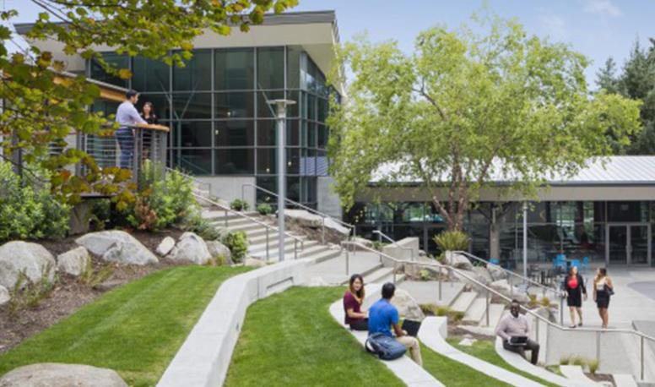


Customer story: Microsoft
Pioneering smart building sustainability solutions with AI
When Microsoft sought to improve building energy efficiencies, it partnered with ICONICS to leverage an Azure-powered solution extended with Power BI, Azure IoT, and Dynamics 365. The solution connects millions of data points daily from disparate systems, delivers clear intelligence, and enables remote device controls. AI is used to aggregate and standardize data and to predict when machines will fail or use more energy than necessary. Now, Microsoft is boosting efficiencies using Microsoft Project Bonsai to help create AI that can support or make decisions in complex systems like HVAC.
Reduce power consumption
Microsoft achieved a 6-10 percent annual reduction in energy usage with its initial solution; new AI technology could reduce an extra 15 percent annually
Compute outcomes beyond human capacity with AI
The AI made simulation-based recommendations to further optimize cooling towers and chillers
Achieve ROI
The company achieved full return on its initial investment in less than 18 months
Notes:
As customer number one for smart building solutions, Microsoft has learned a lot from our own experience optimizing campus operations.
Situation:
When Microsoft set its first carbon emission reduction goal in 2009, we looked across all areas of carbon emission and energy consumption to identify opportunities for optimization.
Our initial effort to reduce power consumption in our buildings was focused on the Microsoft Redmond campus, which spanned 125 buildings with 15 million square feet of office and lab space on 500 acres serving more than 60,000 people. Across the campus, there were multiple disparate building systems, with 100mW peak electrical consumption and $60 million annual utility spend. Our challenge was to leverage technologies to manage this more efficiently in order to reduce emissions and energy costs.
Solution:
Microsoft used an ICONICS solution running on Azure—and extended with Power BI, Azure IoT, and Dynamics 365 Field Service—to remotely monitor and manage buildings across the campus and reduce energy consumption, improve building performance, and increase labor efficiency.
The system allows engineers to get big-picture information at a glance – like how many kilowatts of energy are being consumed across Microsoft headquarters at any one moment. With a few clicks they can also zoom in on one building, one floor or office in that building, or one piece of equipment from a dashboard filled with a colorful collection of maps, dials, lists, and tickers. Now, hundreds of millions of data transactions per day can be accessed from a dashboard rather than requiring workers to crawl through pump rooms or across rooftops to get data.
The software identifies issues large and small and prioritizes them according to the costs they’re incurring. Most problems can be quickly fixed by Microsoft technologists right from their desks. And using predictive maintenance strategies driven by data analytics, the team is able to optimize equipment repair cycles and extend equipment lifespans.
More recently we have used new, cutting edge technology to find greater opportunities for optimization, particularly regarding the energy used to heat and cool Microsoft buildings. Optimizing energy consumption for a building or campus requires the analysis of several layers of variability like controls for cooling towers, water pumps, and chillers. With each layer of complexity, it becomes harder for a human to understand how each variable will impact the outcome of a setting.
Microsoft Project Bonsai – available now in preview – is a low code AI development platform that creates intelligence for industrial controls by infusing the knowledge and wisdom from the people closest to the system from the outset. It was developed precisely to help create AI that can support or make decisions in complex systems like a commercial HVAC system.
To teach the AI, the team first had to give it an objective: reduce energy consumption while maintaining a desired temperature.
From there, the AI had to understand some of the variables and controller options it could change to achieve this goal.
Next, the AI had to understand restrictions and limitations like manufacturing pre-sets or internal chiller controls.
Once the HVAC experts shared the objective, variables, controllers, and restrictions with the AI, the AI practiced in a simulated HVAC system to learn about real-world scenarios it may encounter like heatwaves, winter storms, and equipment variability.
The AI recommended increasing setpoints at the cooling towers and chillers, while also increasing the speed of the pump delivering the water, in order to achieve the objective of energy reduction while maintaining the desired temperature. According to the team, these are counterintuitive optimizations they would never have come to on their own.
Impact:
As a result of initial efforts, Microsoft achieved a 6-10% reduction in annual energy usage with an implementation payback in less than 18 months.
More recently, we have used cutting edge new AI technology to cut our energy usage even more. Using Project Bonsai, we were able to uncover a new plan for optimization in about 2 weeks, with an expected, further reduction in energy of about 15%.
Today, the campus is also operating on 100% carbon-free hydropower and has achieved zero waste certification.
<CLICK>
For more information:
https://www.microsoft.com/en-us/stories/88acres/88-acres-how-microsoft-quietly-built-the-city-of-the-future-chapter-4.aspx
https://customers.microsoft.com/es-es/story/iconics-partner-professional-services-azure-iot
https://customers.microsoft.com/en-us/story/845665-microsoft-autonomoussystems-projectbonsai
https://www.microsoft.com/en-us/ai/autonomous-systems-project-bonsai-how-it-works

Slide 17


Customer story: Ontario Power Generation
Forecasting demand to support decarbonization and improve service
Ontario Power Generation (OPG) built an energy forecasting tool using Microsoft Azure to support data strategy, analytics, and modeling.
“If we can predict prices in jurisdictions other than our own a day or two ahead, we can identify arbitrage opportunities and be in a position to help other markets lower their carbon footprint, taking advantage of the low carbon generation here in Ontario.”
—Goce Jankuloski, OPG Data Scientist and Model Developer
Ontario Power Generation
Looking to a sustainable future
The OPG Energy Market team's initiatives are aligned with OPG’s larger priorities outlined in the company’s recent Climate Change Plan and supports its goal of becoming a net-zero carbon company by 2040, while advancing clean tech solutions that help surrounding markets achieve net-zero carbon economies by 2050.
Notes:
Situation
Managing energy use and reducing carbon emissions is a critical component in tackling the climate crisis. As Ontario’s largest power generator and clean technology innovator, Ontario Power Generation (OPG) is leading the drive for decarbonization while balancing economic and environmental benefits, and Ontario’s electricity needs.
Solution
To support this mission, OPG’s Energy Markets team is using Microsoft AI to help forecast prices, deliver value to Ontario, and move a step closer toward a carbon-neutral future.
Impact
With an Azure-powered Data Driven Trading, or DDT, platform—a collection of tools and AI models—OPG can analyze data and improve forecasting accuracy for electricity pricing. The DDT suite of tools and apps range from simple Power BI reports presenting weather forecasts for North America, to sophisticated AI models that forecast detailed energy trends critical for informing market transactions. The sheer volume of data OPG can consume and feed into a model to produce timely, actionable results is beyond anything imagined just a few years ago. Custom-built and designed with trader logic in mind, this is a big win for the company’s traders whose job and performance relies on producing accurate results faster than their competition.
For more information:
https://news.microsoft.com/en-ca/2021/03/30/ontario-power-generation-powering-a-sustainable-future-with-digital-innovation/

Slide 18
Open discussion

Slide 19
Thank you

Slide 20
Appendix

Slide 21
Microsoft Cloud for Sustainability
Microsoft
Partner Ecosystem
Microsoft Sustainability Manager
Emissions Impact Dashboard for Azure
Emissions Impact Dashboard for Microsoft 365
Planetary Computer
Advisory
System Integrator
ISV Solutions
IoT Solutions
Microsoft Cloud for Sustainability Data Model | Planetary Computer | Partner Extensions
Power Platform | Azure IoT | Azure AI | Azure HPC Project Bonsai
Dataverse Synapse
Azure
Notes:
NOTES: Alec to create

Slide 22



Solution view
Operations
Sources
Microsoft Sustainability Manager
Ecosystem
Operations
Data sources
Sales
Report providers
ERP providers
Procurement
Carbon
Water
Waste
Cloud providers
Data capture
service
Calculation
service
Reporting
service
Manufacturing
Microsoft Cloud for Sustainability data model
Governance partners
Farms
Agriculture
Logistics
Power Platform
Trading
partners
Power
Apps
Power Automate
Power BI
Facilities
Partner solutions
Assets
Other
data sources
Dataverse
Data Lake
Travel
Microsoft Azure
Notes:
<PRESENTER: THIS SLIDE MAY ONLY BE APPROPRIATE FOR A TECHNICAL AUDIENCE.>
What we’re offering is unique, and it’s built on Microsoft Azure and powered by the Power Platform, including Power Apps, Power Automate, and Power BI, which means customers or partners can use Azure and the Power Platform to extend the core capabilities of Microsoft Sustainability Manager quickly and easily with custom industry vertical or horizontal solutions, such as new formulas or reports.
And it combines the power of a publicly available data model with our data calculation, visualization, and reporting capabilities—assembled in one offering that works for any organization.
The solution is extendable on both sides by our growing partner ecosystem. Partners are attaching:
Rich and robust digital solutions to support reporting, governance, and emissions reduction initiatives with additional analytics, digital twins, and AI-driven automation, and
Data connectors to automate data ingestion on the front end of the solution.
There are ample opportunities—for our partners and our customers—to build solutions and services on top of our solution as a product for their own customers, too—extending the ecosystem to reporting providers, governance, and vertical partner opportunities.
<CLICK>

Slide 23









Processes and data flow
Connection available
For continuous data stream
1 Master
data
  System
Unit groups and conversions; report settings
  Reference
  data
Types of instruments, vehicles, fuels, or industrial processes
  Organization
  data
Defines organizational and facility information
  Libraries
Emissions factors and factor mappings
2 Record
3 Report
  Activity
Activity data reflects operational boundaries and is organized into
8 sources of Scope 1 and 2 emissions and
15 categories of Scope 3 emissions
  Emissions
Calculated using activity data combined with relevant emission factors
Analytics
Reports
4 Reduce
Scorecards
Notes:
Let’s look at the process in greater detail. As we’re setting up the solution, we’ll start with collecting master data:
In the System, we preload unit groups and unit conversions, using the most common forms used for carbon accounting.
Reference Data includes data types such as contractual instrument types, vehicle and fuel types or industrial process types. We can establish connectors to reference data sources.
The same is true for Organization Data. We’ll define company information and facilities here, and we can also establish direct connections to these data sources.
The Libraries contain emission factors and factor mappings.
<CLICK>
In step two, Activity data represents the operational boundaries, including everything that is in scope to track that contributes to an organization’s emissions. This will look different for every organization, depending on what they do as part of their business—service organizations, for example, may be focused on different scope categories than industrial or manufacturing organizations.
After master data and activities are accounted for, the Emissions are calculated using activity data combined with relevant emission factors.
<CLICK>
And once you’ve calculated emissions, the results and insights are all generated through Analytics and displayed in dashboards and out-of-the-box Reports.
<CLICK>
The solution populates Scorecards used to help track progress towards your goals.
<CLICK>

Slide 24
Customer story: International Organization for Migration
Improving security and resiliency by transitioning to the cloud
The International Organization for Migration (IOM) was beginning to experience significant disruptions to its operations because of its aging on-premises infrastructure. Manual IT maintenance had become burdensome, costs were prohibitive, and security was difficult to maintain. The United Nations agency decided to close its datacenters and move its applications and data to Microsoft Azure. It chose Azure landing zones to underpin all of its services and uses Azure Backup and Azure Site Recovery to protect its assets.
Data integrity
With VMs now in the cloud, IOM no longer has to manually update operating systems or perform many other tedious, manual systems administration tasks across multiple datacenters and frontline deployments
No longer “data rich but information poor”
The agency laid the foundation for an ambitious transformation to derive deep insights from its data through advanced analytics
Reduced energy consumption and emissions
IOM reduced power consumption and cut its carbon emissions footprint by 92 percent, or 594 tons of CO2e saved annually
Notes:
Let’s look at a customer that recently migrated workloads to the cloud.
Situation
Since 1951, the International Organization for Migration (IOM) has promoted international cooperation and supported the orderly and humane management of displaced people, refugees, and migrant workers.
IOM decided to position itself as a leader and innovator by strengthening its framework for data governance, resilience, and mobility to become a more agile and sustainable organization. To achieve its vision, IOM resolved to decentralize its operations, make its IT infrastructure highly secure, resilient, and efficient, transform the agency’s internal business processes, and adopt scalable and flexible solutions based on actionable data to speed decision making and meet migrants’ needs in agile, more responsive ways.
The agency’s aging infrastructure was becoming an issue. IOM had three on-premises datacenters and 500 old, overprovisioned virtual machines (VMs). Security, backups, and monitoring relied on systems administrators for oversight and deployment. Networking and hardware problems in IOM datacenters caused unplanned outages, some of which significantly disrupted operations, and data security was a concern. Rising maintenance and renewal costs also made it difficult to update critical components, and by 2019, the agency estimated that 80 percent of its servers needed replacement.
IT leaders concluded that IOM should get out of the datacenter business and refocus on its humanitarian mission of supporting end-to-end migrant journeys.
Solution
IOM soon realized that it needed strategic partners to achieve its goal, and after careful planning and risk mitigation, the agency chose Microsoft Azure as its cloud platform. IOM determined that Microsoft delivered the best value, the maximum level of cloud technology investment, and the most support for its staff throughout the organization’s cloud journey. IOM brought Microsoft Partner Network member Kainos onboard because of its broad cloud migration experience in both the private and public sectors and its shared organizational values.
A key component of the deployment is Azure landing zones, wherein applications and IOM’s development, test, and operations teams, along with other staff, can use Azure services in a standard, policy-driven, monitorable, and highly secure way. Azure landing zones underpin all the agency’s services, taking advantage of automation tooling and continuous integration and continuous delivery pipelines to achieve a repeatable deployment model that supports future expansion of IOM’s global cloud footprint, including the accommodation of multiple remote sites.
Impact
IOM significantly improved its security, risk management, and compliance by transitioning to the cloud. With its VMs now in the cloud, the agency no longer has to manually update operating systems or perform many other tedious, manual systems administration tasks across multiple datacenters and frontline deployments. Data residency was also important, and IOM worked with Microsoft to help ensure that data gets hosted in locations that meet different stakeholders’ requirements.
The agency is not only more flexible, secure, and responsive, but it has also laid the foundation for an ambitious transformation to derive deep insights from its data through advanced analytics and will be able to tell individual migrant stories accurately.
IOM chose Microsoft and Kainos in part because they could help the agency’s IT staff quickly add the skills needed to support the new environment. As of June 2022, almost 100 staff members have completed Azure trainings, and more than 50 have successfully completed Azure certifications.
The agency also credits its move to the cloud for providing a welcome sustainability boost. By retiring its on-premises datacenters and diminishing the computational loads stemming from outdated code, IOM reduced power consumption and cut its carbon emissions footprint by 92 percent, or 594 tons of CO2e saved annually.
The retirement of its technical debt has removed the need to reinvest in hardware, and IOM can now devote more money to programs and missions, facilitating more agile development and faster time to innovation.
<CLICK>
For more information:
https://customers.microsoft.com/en-us/story/1505667739375662033-international-organization-for-migration-nonprofit-azure

Slide 25
Customer story: Microsoft
Pioneering smart building sustainability solutions with AI
When Microsoft sought to improve building energy efficiencies, it partnered with ICONICS to leverage an Azure-powered solution extended with Power BI, Azure IoT, and Dynamics 365. The solution connects millions of data points daily from disparate systems, delivers clear intelligence, and enables remote device controls. AI is used to aggregate and standardize data and to predict when machines will fail or use more energy than necessary. Now, Microsoft is boosting efficiencies using Microsoft Project Bonsai to help create AI that can support or make decisions in complex systems like HVAC.
Reduce power consumption
Microsoft achieved a 6-10 percent annual reduction in energy usage with its initial solution; new AI technology could reduce an extra 15 percent annually
Compute outcomes beyond human capacity with AI
The AI made simulation-based recommendations to further optimize cooling towers and chillers
Achieve ROI
The company achieved full return on its initial investment in less than 18 months
Notes:
As customer number one for smart building solutions, Microsoft has learned a lot from our own experience optimizing campus operations.
Situation:
When Microsoft set its first carbon emission reduction goal in 2009, we looked across all areas of carbon emission and energy consumption to identify opportunities for optimization.
Our initial effort to reduce power consumption in our buildings was focused on the Microsoft Redmond campus, which spanned 125 buildings with 15 million square feet of office and lab space on 500 acres serving more than 60,000 people. Across the campus, there were multiple disparate building systems, with 100mW peak electrical consumption and $60 million annual utility spend. Our challenge was to leverage technologies to manage this more efficiently in order to reduce emissions and energy costs.
Solution:
Microsoft used an ICONICS solution running on Azure—and extended with Power BI, Azure IoT, and Dynamics 365 Field Service—to remotely monitor and manage buildings across the campus and reduce energy consumption, improve building performance, and increase labor efficiency.
The system allows engineers to get big-picture information at a glance – like how many kilowatts of energy are being consumed across Microsoft headquarters at any one moment. With a few clicks they can also zoom in on one building, one floor or office in that building, or one piece of equipment from a dashboard filled with a colorful collection of maps, dials, lists, and tickers. Now, hundreds of millions of data transactions per day can be accessed from a dashboard rather than requiring workers to crawl through pump rooms or across rooftops to get data.
The software identifies issues large and small and prioritizes them according to the costs they’re incurring. Most problems can be quickly fixed by Microsoft technologists right from their desks. And using predictive maintenance strategies driven by data analytics, the team is able to optimize equipment repair cycles and extend equipment lifespans.
More recently we have used new, cutting edge technology to find greater opportunities for optimization, particularly regarding the energy used to heat and cool Microsoft buildings. Optimizing energy consumption for a building or campus requires the analysis of several layers of variability like controls for cooling towers, water pumps, and chillers. With each layer of complexity, it becomes harder for a human to understand how each variable will impact the outcome of a setting.
Microsoft Project Bonsai – available now in preview – is a low code AI development platform that creates intelligence for industrial controls by infusing the knowledge and wisdom from the people closest to the system from the outset. It was developed precisely to help create AI that can support or make decisions in complex systems like a commercial HVAC system.
To teach the AI, the team first had to give it an objective: reduce energy consumption while maintaining a desired temperature.
From there, the AI had to understand some of the variables and controller options it could change to achieve this goal.
Next, the AI had to understand restrictions and limitations like manufacturing pre-sets or internal chiller controls.
Once the HVAC experts shared the objective, variables, controllers, and restrictions with the AI, the AI practiced in a simulated HVAC system to learn about real-world scenarios it may encounter like heatwaves, winter storms, and equipment variability.
The AI recommended increasing setpoints at the cooling towers and chillers, while also increasing the speed of the pump delivering the water, in order to achieve the objective of energy reduction while maintaining the desired temperature. According to the team, these are counterintuitive optimizations they would never have come to on their own.
Impact:
As a result of initial efforts, Microsoft achieved a 6-10% reduction in annual energy usage with an implementation payback in less than 18 months.
More recently, we have used cutting edge new AI technology to cut our energy usage even more. Using Project Bonsai, we were able to uncover a new plan for optimization in about 2 weeks, with an expected, further reduction in energy of about 15%.
Today, the campus is also operating on 100% carbon-free hydropower and has achieved zero waste certification.
<CLICK>
For more information:
https://www.microsoft.com/en-us/stories/88acres/88-acres-how-microsoft-quietly-built-the-city-of-the-future-chapter-4.aspx
https://customers.microsoft.com/es-es/story/iconics-partner-professional-services-azure-iot
https://customers.microsoft.com/en-us/story/845665-microsoft-autonomoussystems-projectbonsai
https://www.microsoft.com/en-us/ai/autonomous-systems-project-bonsai-how-it-works

Slide 26



Customer story: Impact Observatory
Using AI to map a better future
Impact Observatory set out to produce a global land use and land cover map with higher resolution than any existing, freely available map to drive global geospatial understanding. They turned to Microsoft Azure HPC + AI, using a combination of Azure Virtual Machines, Azure Batch, Azure Blob Storage and the Planetary Computer to develop the Esri 2020 Land Cover map.
Maximizing processing power and efficiency
Unprecedented results in speed, scale, and accuracy allow decision makers to achieve sustainable development, head off climate change, and preserve & restore biodiversity
Achieving time and cost savings
Impact Observatory can now generate an updated map in less than a week compared with traditional maps that take a year or more
Notes:
The Washington, D.C.–based tech startup Impact Observatory is using AI to revolutionize automated mapping speed and detail.
Situation
Access to near real-time land use and land cover (LULC) maps is critical for a sustainable future, which is why Impact Observatory is working to transform automated LULC map making with AI-driven algorithms and datasets.
Impact Observatory wanted to produce a global land use and land cover map with higher resolution than any existing freely available map.
Solution
The company turned to Microsoft Azure HPC + AI, using a combination of Azure Virtual Machines, Azure Batch, Azure Blob Storage and the Planetary Computer to develop the Esri 2020 Land Cover map and achieve unprecedented results in speed, scale, and accuracy.
Impact
Impact Observatory improved its flexibility and realized time and cost savings, in addition to driving global geospatial understanding.
It can now generate an updated map in less than a week compared with traditional maps that take a year or more.
The company credits much of its map’s technological prowess to Azure, including Batch and Azure HPC + AI, and taking advantage of the open science data hosted on the Planetary Computer.
Annual LULC maps are available on the Planetary Computer.
<CLICK>
For more information:
https://customers.microsoft.com/en-us/story/1459632165188903952-impact-observatory-professional-services-azure-hpc

Slide 27
Customer story: Ontario Power Generation
Forecasting demand to support decarbonization and improve service
Ontario Power Generation (OPG) built an energy forecasting tool using Microsoft Azure to support data strategy, analytics, and modeling.
“If we can predict prices in jurisdictions other than our own a day or two ahead, we can identify arbitrage opportunities and be in a position to help other markets lower their carbon footprint, taking advantage of the low carbon generation here in Ontario.”
—Goce Jankuloski, OPG Data Scientist and Model Developer
Ontario Power Generation
Looking to a sustainable future
The OPG Energy Market team's initiatives are aligned with OPG’s larger priorities outlined in the company’s recent Climate Change Plan and supports its goal of becoming a net-zero carbon company by 2040, while advancing clean tech solutions that help surrounding markets achieve net-zero carbon economies by 2050.
Notes:
Situation
Managing energy use and reducing carbon emissions is a critical component in tackling the climate crisis. As Ontario’s largest power generator and clean technology innovator, Ontario Power Generation (OPG) is leading the drive for decarbonization while balancing economic and environmental benefits, and Ontario’s electricity needs.
Solution
To support this mission, OPG’s Energy Markets team is using Microsoft AI to help forecast prices, deliver value to Ontario, and move a step closer toward a carbon-neutral future.
Impact
With an Azure-powered Data Driven Trading, or DDT, platform—a collection of tools and AI models—OPG can analyze data and improve forecasting accuracy for electricity pricing. The DDT suite of tools and apps range from simple Power BI reports presenting weather forecasts for North America, to sophisticated AI models that forecast detailed energy trends critical for informing market transactions. The sheer volume of data OPG can consume and feed into a model to produce timely, actionable results is beyond anything imagined just a few years ago. Custom-built and designed with trader logic in mind, this is a big win for the company’s traders whose job and performance relies on producing accurate results faster than their competition.
For more information:
https://news.microsoft.com/en-ca/2021/03/30/ontario-power-generation-powering-a-sustainable-future-with-digital-innovation/

Slide 28
Continuous innovation
Notes:
Thanks, Rosie.
We’ve made big strides over the past year with Microsoft Cloud for Sustainability, and our story continues to grow broader and stronger. Lets take a look.
<CLICK>

Slide 29

Key enhancements
in market by November 2022
Additional Scope 3 calculation methodologies
5: Emissions from waste
8 & 13: Emissions from leased assets
Geo expansion
UK and APAC region deployment
Data model extensibility
Water addition to data model
Refer to custom entities when building calculations
Add attributes to existing entities for use in calculations
Emissions Impact Dashboard enhancements
Microsoft 365 General Availability
Microsoft Cloud for Sustainability APIs
Environmental Credit Service
LinkedIn Learning modules
aka.ms/cloudforsustainabilityupdates
Notes:
Details about our annual wave 1 and wave 2 feature release plans are available online – and I’m happy to share highlights with you today.
Since Cloud for Sustainability was released earlier this year, since then we’ve added:
New Calculation methodologies for Scope 3 categories, for:
category 5, emissions from waste generated in operations, and
categories 8 and 13: emissions from leased assets, both upstream and downstream.
We’ve expanded deployment to the UK and APAC.
We’ve extended the data model to allow organizations to add custom entities, ingest those attributes, and use those in their calculations. This allows organizations to add the extra level of detail they need to calculate emissions more precisely.
We’re expanding our Emissions Impact Dashboards.
We’re introducing the Environmental Credit Service, and
We’re offering new LinkedIn Learning modules about sustainability.
Let’s expand on some of these…
<CLICK>

Slide 30
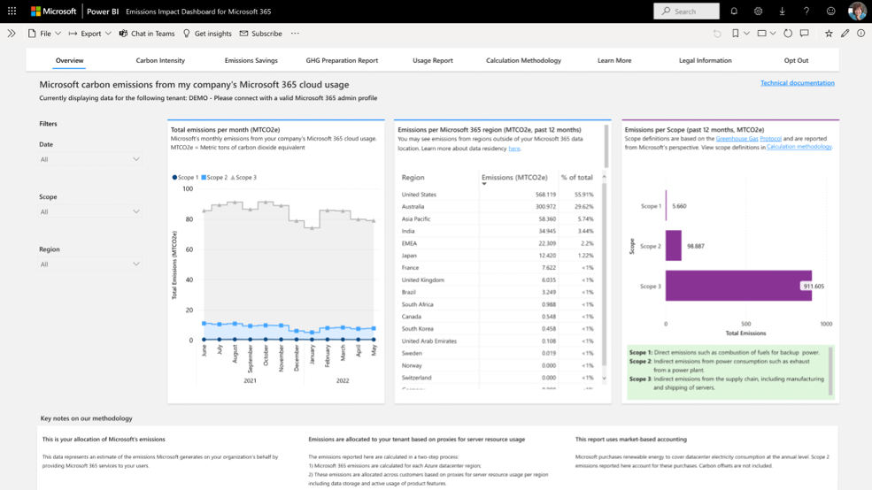
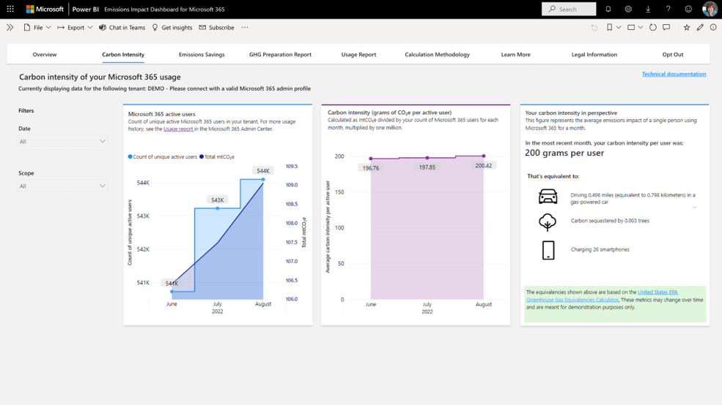
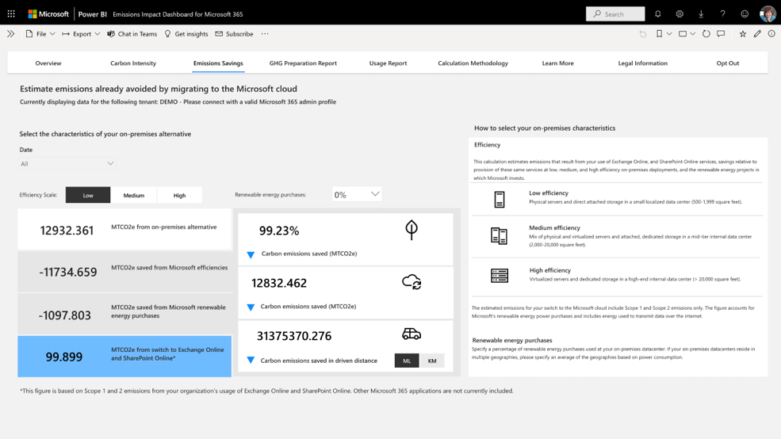
Emissions Impact Dashboard for Microsoft 365
Tracks emissions related to using Microsoft 365 core cloud services including Exchange Online, SharePoint
Online, OneDrive, Microsoft Teams, Word, Excel, and PowerPoint
Generally available October 2022
aka.ms/m365-emissions
Notes:
Today, we’re pleased to announce that the Emissions Impact Dashboard for Microsoft 365 is generally available.
This provides a transparent, quantitative picture of the greenhouse gas emissions associated with an organization’s use of Microsoft 365 cloud services, like sending emails through Exchange Online, storing files in SharePoint, and joining Microsoft Teams meetings.
Since launching the preview version of this application in February this year, we have expanded the history to show a full 12 months’ worth of emissions, added in emissions associated with usage of Word, Excel, and PowerPoint, and added a new 'carbon intensity' tab that allows you to quickly quantify emissions per active user and compare it to other common sources of emissions. The dashboard allows you to estimate the greenhouse gas emissions your organization has already avoided by using cloud instead of on-premises versions of Exchange and SharePoint.
<CLICK>
Source:
Emissions Impact Dashboard for Microsoft 365, Microsoft, https://www.microsoft.com/en-us/sustainability/emissions-impact-dashboard

Slide 31
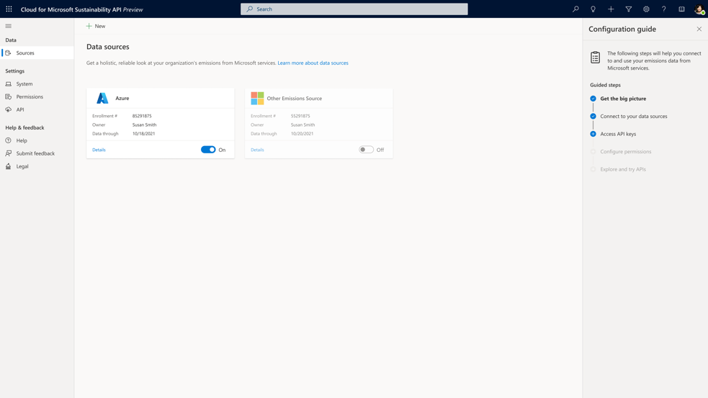
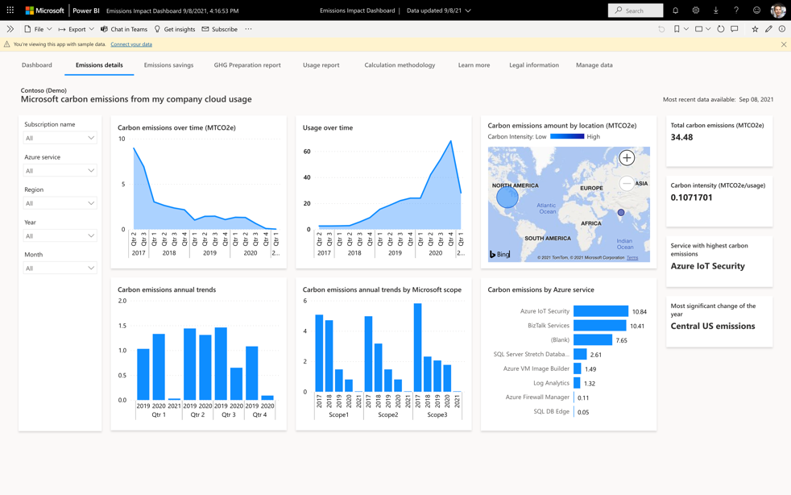
Emissions Impact Dashboard for Azure and Cloud for Sustainability API
Simplify carbon reporting with easy
access to report on Scope 3 emissions
from your cloud infrastructure
aka.ms/microsoftemissionsimpactdashboard
Cloud for Sustainability API
available November 1 for partners and customers to access Emissions Impact Dashboard data
aka.ms/sustainabilityAPI
Notes:
The Emissions Impact Dashboard tracks your organization’s Scope 3 carbon emissions related to your use of Microsoft Azure cloud services and estimates how to further reduce emissions by moving additional applications and services to the cloud.
Using third-party validated methodology, the application factors in Microsoft Scopes 1, 2, and 3 (direct and indirect) emissions as well as the efficiency of a customer’s on-premises environments.
We are also excited to announce that as of November 1, customers and partners can access Emissions Impact Dashboard data directly through the Microsoft Cloud for Sustainability API.
More information and how-to tutorials are available online.
<CLICK>
Source:
Emissions Impact Dashboard, Microsoft, https://www.microsoft.com/en-us/sustainability/emissions-impact-dashboard

Slide 32
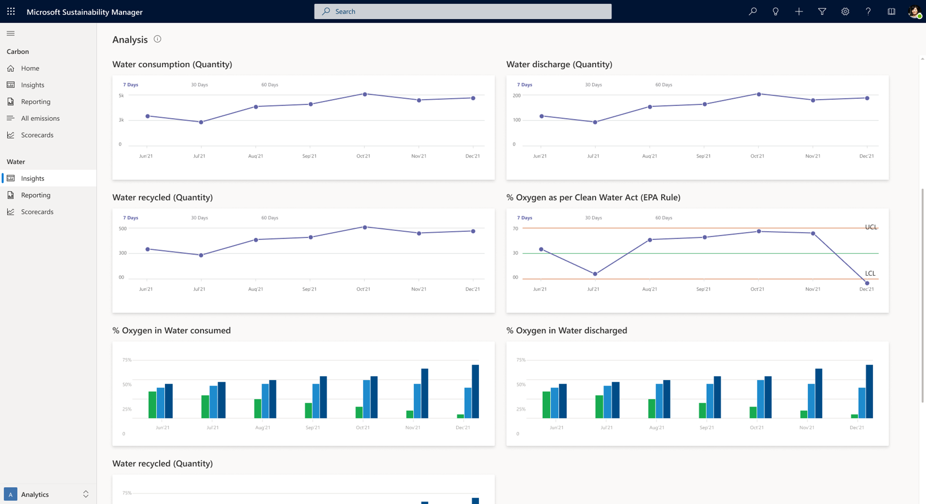
Water capability highlights
Wave 2 – by March 2023
Data model expanded to
include water
Unify water quantity and quality data across sites
Manage water mass balance
Drive water sustainability goals
Notes:
We’re thrilled to share our progress in building and offering water capabilities.
We recently expanded the Microsoft Cloud for Sustainability data model in preview to include water. We’d like you to start looking at it and giving us your feedback.
By March, we’ll release additional capabilities to help you manage water quantity and quality as well as the ability to calculate your water mass balances to drive sustainability goals.
<CLICK>

Slide 33

Select future enhancements*
Planned for March 2023
Water enhancements
Supplier engagement and rating integration
More Scope 3 calculation methodologies
7: Emissions from employee commuting
12: Emissions from end-of life treatment of sold products
Product carbon footprint data model expansion
New AI capabilities
Cloud for Sustainability API enhancements
New partner integrations and solutions
aka.ms/cloudforsustainabilityupdates
* Subject to change
Notes:
In Wave 2 releases between now and March, we’ll be rolling out a variety of additional capabilities:
In addition to adding water capabilities, we’ll be implementing new supplier engagement tools and integrating supplier ratings into the solution.
We’ll be adding calculation methodologies for Scope 3 categories 7 and 12.
We’re enhancing the data model by adding product-based carbon calculation mechanisms – building on the process-based mechanisms available today.
We’ll be adding new AI capabilities, API enhancements, and new partner integrations and solutions, too.
Now, I’ll invite Brandon Potter to share how our partners are helping us address our customers’ needs.
<CLICK>
This content was removed:
We’re enabling customers to more clearly account for market-based emissions by enabling market-based calculations in addition to location-based calculations from a single activity data set.
We’re releasing audit traceability down to the line-item level, so you can track every step of how source data was collected and emissions were calculated. It dates, timestamps, and assigns sources to emissions data changes as they’re made, so you can validate calculations and easily generate an audit report.
We’re enabling configurable dimensions that allow customers to easily add new attributes to ingested data to use in calculations.
We’ll be adding support for OCR, and API support for Microsoft 365 emissions.
We’ll be expanding deployment to additional geographies, and
We’ll be providing early access availability to select features like automated emissions allocation to specific entities, such as head count.

